Slide 1
COMP1860 Building our Digital World: Computer Systems & Architecture
S1.W7.L2: Sequential Logic & Memory
Leandro Soares Indrusiak

Slide 2
Objectives
Understand the use of clocks(时钟) in computer systems
Explain the difference between Sequential & Combinational logic
Understand how Registers work
Implement the circuits (CHIPS) required to implement a register and a Program Counter

Slide 3
Memory
load
Basic abstractions:
“Loading” a value
“Storing” a value
in
out
Register
16
16
time
1 2 3 4 5 6 7 205 206 207 208 209 210 211 ...
...
x = 17
, 17, 17, 17, 17, 17, 17, ... ,
(cycles)
loading
storing
, 21, 21, 21, 21, 21, 21, ...
x = 21
loading
storing
The challenge: Building chips that realize this functionality.
Notes:
Unlike the DFF, which remembers only the bit from the previous time unit.

Slide 4
Memory
RAM
0
Register
1
Register
Data
Flip-Flop
1-bit
register
multi-bit
register
...
n-1
Register
?
Bit
Bit
...
Bit
DFF
DFF
Bit
Register
RAMn
The challenge: Building chips that realize this functionality.

Slide 5
Representing time(代表时间)
physical time:
Arrow of time:
Continuous（连续的）

Slide 6
Representing time
physical time:
Arrow of time:
Continuous
clock:
时钟
1
0

Slide 7
Representing time
physical time:
Arrow of time:
Continuous
连续的时间
离散的时间
设计决策：仅当一个时间步长前进到另一个时间步长时，轨迹状态才会改变
clock:
1
Discrete time:
Design decision:
Track state changes only when advancing from one time-step to another
0
time: 1 2 3 4 5 . . .
time-step
time-step

Slide 8
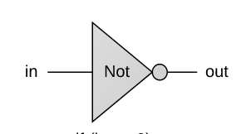
Chip behavior over time (example: Not gate)
physical time:
Arrow of time:
Continuous
连续的时间
离散的时间
设计决策：仅当一个时间步长前进到另一个时间步长时，轨迹状态才会改变
clock:
1
Discrete time:
Design decision:
Track state changes only when advancing from one time-step to another
0
time: 1 2 3 4 5 . . .
time-step
in:
(arbitrary values)
time-step
in:
1
0
out:
(Not(in))
1
0
(example)

Slide 9
Chip behavior over time (芯片随时间变化的行为example: Not gate)
physical time:
Arrow of time:
Continuous
clock:
1
Discrete time:
Design decision:
Track state changes only when advancing from one time-step to another
0
time: 1 2 3 4 5 . . .
in:
(arbitrary values)
1
0
out:
(Not(in))
1
0
(example)
输入和输出信号的期望/理想化行为：
这就是我们希望硬件的行为方式

Slide 10
Chip behavior over time (example: Not gate)
physical time:
Arrow of time:
Continuous
clock:
1
Discrete time:
Design decision:
Track state changes only when advancing from one time-step to another
0
time: 1 2 3 4 5 . . .
in:
(arbitrary values)
1
0
out:
(Not(in))
1
0
(example)
Actual behavior of the in and out signals:
Influenced by physical time delays
受物理时间延迟的影响

Slide 11
Chip behavior over time (example: Not gate)
1. Propagation delays 传播延迟：
chip中组合逻辑门的级联延迟累加，input信号需要按顺序依次通过这些门（后续门依赖前面门的输出信号），信号传播需要时间。
晶体管开关延迟
2. Computation delays 计算延迟
完成一次完整计算操作所需的总时间，包含传播延迟及其他系统开销
时钟周期约束
寄存器开销
physical time:
Arrow of time:
Continuous
clock:
1
Discrete time:
Design decision:
Track state changes only when advancing from one time-step to another
0
time: 1 2 3 4 5 . . .
in:
(arbitrary values)
1
0
out:
(Not(in))
1
0
(example)
Time delays
Propagation delays
Computation delays
Cycle length

Slide 12
Chip behavior over time (example: Not gate)
以 16 位加法器为例
传播延迟产生：
电流从 A[0] 输入 →
经过第一级全加器 →
进位传到第二级 → ...
最终和输出
计算延迟产生：
加法运算本身：
传播延迟（约 50ps）+
建立时间（20ps）+
时钟周期（200ps）
physical time:
Arrow of time:
Continuous
clock:
1
Discrete time:
Design decision:
Track state changes only when advancing from one time-step to another
0
time: 1 2 3 4 5 . . .
in:
(arbitrary values)
1
0
out:
(Not(in))
1
0
(example)
Time delays
Propagation delays
Computation delays
Cycle length
Design parameter
Set to be slightly > max(time delays)
时钟周期长度设置为稍
大于时间延迟的最大值

Slide 13
Chip behavior over time (example: Not gate)
physical time:
Arrow of time:
Continuous
clock:
1
Discrete time:
Design decision:
Track state changes only when advancing from one time-step to another
0
time: 1 2 3 4 5 . . .
in:
(arbitrary values)
1
0
out:
(Not(in))
1
0
(example)
Resulting effect: 结果影响
Combinational chips react “immediately” to their inputs 组合芯片对输入“立即”做出反应
Facilitated by the decision to track changes only at cycle ends
得益于「仅在时钟周期结束时采样状态变化」这一设计决策

Slide 14
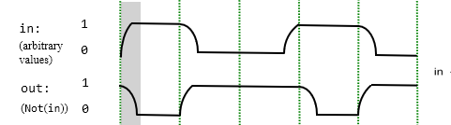
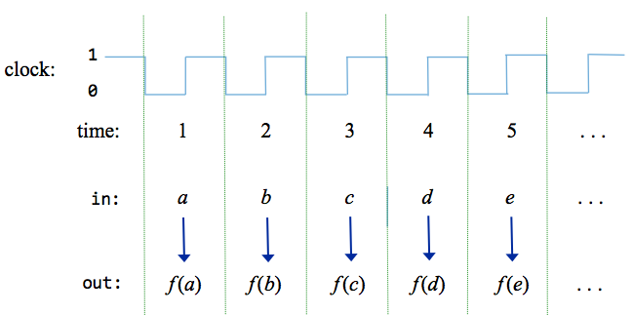
The clock neutralizes the time delays if we decide to use discrete time
cycle length
如果我们决定使用离散时间，时钟会抵消时间延迟
tick
tock
time-step:
Chip’s input:
a
b
c
d
e
毛刺
真正的输出
组合逻辑在输入变化时，输出可能短暂出现
尖峰脉冲（毛刺），然后才稳定到正确值。
时钟边沿只在周期末尾采样，此时组合逻辑
早已稳定，毛刺已被过滤掉。
Chip’s output:
f(a)
f(b)
f(c)
f(d)
f(e)
Set the cycle length to be slightly > than the maximum time delay, and…
将时钟周期长度设置为略大于最大时间延迟
Decide to use the chips’s outputs only at the end of cycles (time-steps),
ignoring what happens within cycles
只在周期结束时（时间步长）使用芯片的输出，忽略周期内发生的事情

Slide 15
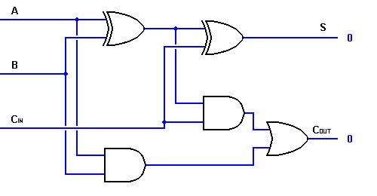
Combinational logic (组合逻辑电路)
Combinational logic:
The output depends
on the current inputs
The clock is used to stabilize outputs
时钟用于稳定输出
Combinational logic的例子
毛刺
真正的输出
组合逻辑在输入变化时，输出可能短暂出现尖峰脉冲（毛刺），然后才稳定到正确值。
时钟边沿只在周期末尾采样，此时组合逻辑早已稳定，毛刺已被过滤掉。

Slide 16
Clocks（时钟）
In most computers the passage of time（时间流逝） is represented by a master clock（主时钟）
A clock has two phases tick/tock (or low/high) （一个时钟有两个相位嘀/嗒，或高/低）
The frequency of the clock, determine the speed of computation
The waveform need not be regular it is the transition that is important(时钟波形无需规整，关键在于其电平跳变: low -> high or high -> low)

Slide 17
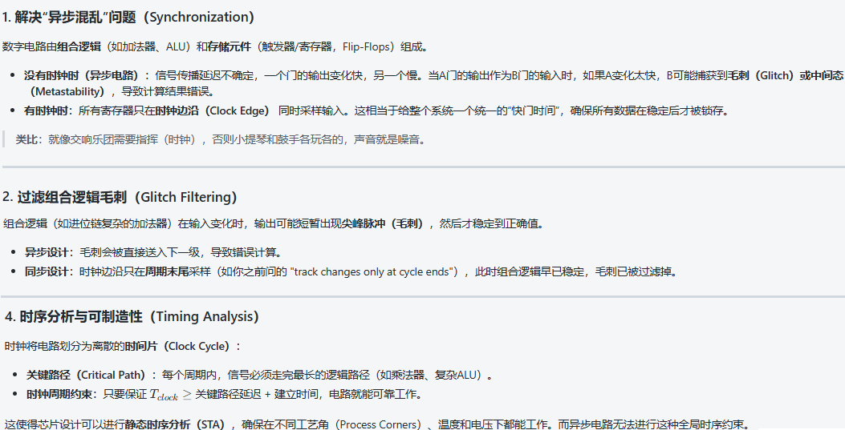
为什么需要Clocks（时钟)?

Slide 18
Clock

Slide 19
Clock: Simulated implementation(时钟：模拟实现)
Interactive simulation(交互模拟)
A clock button can be used to generate a
sequence of tick-tock signals:
0, 0+, 1, 1+, 2, 2+, 3, 3+, ...

Slide 20
Clock: Simulated implementation
tock
tick
Interactive simulation (交互模拟)
A clock icon can be used to generate a
sequence of tick-tock signals:
0, 0+, 1, 1+, 2, 2+, 3, 3+, ...
Script-based simulation(基于脚本的模拟)
“tick” and “tock” commands can be used to advance the clock:
...
// Sets inputs, advances the clock, and
// writes output values as it goes along.
set in 19,
set load 1,
tick,
output,
tock,
output,
tick, tock,
output,
...
“tick”和“tock”命令可用于前进一个时钟周期：
tick对应低电平 （逻辑0）
tock对应高电平（逻辑1）
执行tock的瞬间就是时钟上升沿，会触发所有时序器件（DFF、Bit、寄存器等）采样输入、更新输出。

Slide 21
Clock: Physical implementation (时钟：物理实现)
Physical clock
An oscillator is used to deliver an ongoing train of “tick/tock” signals
振荡器用于传递一系列持续的“滴答/滴答”信号
“1 MHz electronic oscillator circuit which uses the resonant properties of an internal quartz crystal to control the frequency. Provides the clock signal for digital devices such as computers.” (Wikipedia)
1 MHz电子振荡器电路，利用内部石英晶体的谐振特性来控制频率。为计算机等数字设备提供时钟信号
The oscillator’s output is connected to all the time-based (clocked) chips in the computer
振荡器的输出连接到计算机中所有基于时间（时钟）的芯片
Chip diagram convention:
A triangle icon represents a clock signal input

Slide 22
Memory specification
1 1
We want a logic circuit such that
out(t) = in(t-1)
where t is a discrete time interval
The output of the gate at time t is dependent on the input of the gate at the previous time step (t-1)
时间t的门输出取决于前一时间步（t-1）的门输入
Functionality implemented by a Data Flip Flop (DFF)
通过数据触发器（DFF）实现的功能
0 0
out(t) = in(t-1)
t | in | out
0 | 0 | ?
1 | 1 | 0
2 | 1 | 1
3 | 0 | 1
4 | 1 | 0

Slide 23
S-R Latch（异步S-R锁存器）
Simple flip flop（简单翻转）
S bit is set bit
R bit is reset bit
Implemented as 2 NOR gates
NOR = not (a or b)
S and R set bit stored as 1 or 0 respectively
S和R设置位分别存储为1或0
S-R锁存器是数字电路里最基础的异步1比特存储单元，所有更复杂的寄存器、内存都是由它衍生而来。
它是第一个能「记住1比特数据」的逻辑单元，有两个输入、两个互补输出：
当S=1，R = 0 时， Set 1Bit = 1
当S=0，R = 1 时，Reset 1Bit = 0
当S=0，R = 0 时，1Bit内容保持不变。实现最简单的内存「记忆」功能。
当S=1，R = 1 时，电路会产生随机值，实际电路中永远不会出现这个组合。

Slide 24
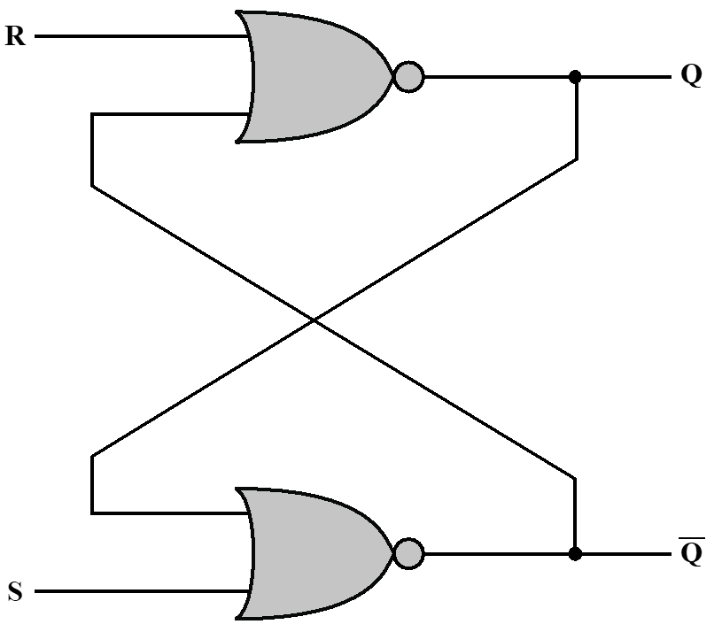
Characteristic Table
Similar to truth table
Determines next state based on inputs and current state
所谓current state, 就是存储在S-R Latch中的1-bit数
所谓next state，就是Q反馈回input时算出来的下一个output
S | R | Current State | Next State | State
0 | 0 | 0 | 0 | Hold
0 | 0 | 1 | 1 | Hold
0 | 1 | 0 | 0 | Reset
0 | 1 | 1 | 0 | Reset
1 | 0 | 0 | 1 | Set
1 | 0 | 1 | 1 | Set
1 | 1 | 0 | - | Invalid
1 | 1 | 1 | - | Invalid
Simplified Characteristic Table
S | R | Q_{n+1} | State
0 | 0 | Q_{n} | Hold
0 | 1 | 0 | Reset
1 | 0 | 1 | Set
1 | 1 | – | Invalid

Slide 25
S-R Latch为什么能锁存住值（When S = 0 R = 0）
情景1： Current State Q = 1 情景2： Current State Q = 0
current：1
current：0
0
0
0
next： 1
next： 0
1
current: 0
current: 1
1
0
next： 0
next： 1
0
0
由此可见： 当 S = 0， R = 0时， Q内无论存储是1还是0，Next State Q都保持不变，即内存的值锁存住了

Slide 26
S-R Latch修改值(内存写）
情景1： S = 0 R = 1 Q任意： Q清零 情景2：S = 1 R = 0 Q任意：Q置1
current：X
current：X
1
0
!X
next： 0
0
next： 1
current: !X
current: !X
X
X
next： 1
next： 0
0
1

Slide 27
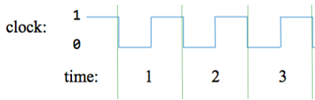
Clocked S-R Latch(同步时钟控制S-R锁存器，S-R Latch + Clock同步)
S-R Latch
S-R Latch is asynchronous(异步)
  It will change state after a certain time, but that time is not fixed
  它会在一段时间后改变状态，但该时间不是固定的
Useful to have system where we know where we can predict when state will change
如一个系统，可以预测状态何时会改变，这很有用
Clocked SR Latch synchronises (同步) to clock pulse(时钟脉冲)
  S & R inputs are only passed to NOR gates when clock pulses
  S&R输入仅在时钟脉冲到达时传递到NOR门
Clocked S-R Latch在S-R Latch前加入AND，用来控制R,S信号是否能进入S-R Latch。
当Clock低电平进入and门时，R,S信号被切断，此时R=0，S=0，Hold状态，数据被保持。
当Clock高电平进入and门时，R,S信号被放行，此时R=0，S=1 或 R=1 S=0 ; 数据被置1或清0

Slide 28
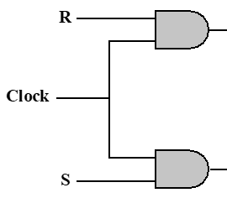
用Clocked S-R Latch来改进S-R Latch的原因
S-R锁存器的两个大问题：
完全异步：S/R输入的任何跳变（哪怕是毛刺、干扰）都会立刻改变输出，没有统一的时间基准，大规模系统里会出现随机的逻辑冲突；
无控制窗口：输入永远生效，无法做到「只在需要的时候采样输入」。
locked S-R Latch解决了这两个问题：
它加了时钟控制，只有时钟处于有效电平的窗口内，S/R的输入才会影响输出
时钟无效时，无论S/R怎么跳变，输出都保持原状态不变，完美实现了「同步屏蔽干扰」的需求。
所有外部输入的信号（比如按键、传感器、其他模块的输出）都是异步的，自带毛刺、抖动，如果没有时钟控制，这些毛刺会直接触发普通S-R锁存器乱翻。加了时钟后，只有时钟有效窗口内的信号才会被采样，窗口外的干扰全部被屏蔽，输出稳定性大幅提升。
普通S-R锁存器的状态变化是随机的，发生在S/R跳变的任意时刻；而Clocked S-R Latch的状态变化只发生在CLK的有效窗口内，整个系统的所有状态变化都有统一的时间基准，方便做时序约束、时序分析，是构建复杂同步时序电路的基础单元
毛刺
真正的输出

Slide 29
D Flip Flop（D触发器）
Two sets of inputs which change state are S=0, R=1 and S=1, R=0
Can be implemented as single input
  One input goes to one NOR
  Negated input to other NOR
你可以把D触发器理解成一个只在闹钟响的瞬间记事的笔记本：
闹钟就是时钟（CLK），只有闹钟响（边沿到来）的瞬间，你才会记下当前看到的内容（D端的输入）；
闹钟不响的时候，不管周围发生什么（D端怎么变），你都一直记住上次记下的内容（输出Q保持）；
而且你只会记0或者1，不会出现矛盾的内容（没有禁止态），非常可靠。
R
S
Characteristic Table
D | Q_{n+1} | State
0 | 0 | Reset
1 | 1 | Set
Notes:
One problem with S–R flip-flop is that the condition R = 1,S = 1 must be avoided. One way to do this is to allow just a single input. The D flip-flop accomplishes this. Figure 12.27 shows a gate implementation of the D flip-flop. By using an inverter, the non-clock inputs to the two AND gates are guaranteed to be the opposite of each other.
The D flip-flop is sometimes referred to as the data flip-flop because it is, in effect, storage for one bit of data. The output of the D flip-flop is always equal to the most recent value applied to the input. Hence, it remembers and produces the last input. It is also referred to as the delay flip-flop, because it delays a 0 or 1 applied to its input for a single clock pulse.

Slide 30
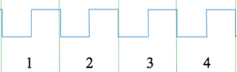
用D Flip Flop来改进Clocked S-R Latch的原因
Clocked S-R Latch的2个问题：
依然存在禁止态： S和R同时为1时，输出Q和Q非都为0，违反逻辑互补规则，会导致电路冲突。
依然是电平敏感：CLK有效窗口内的毛刺、干扰还是会直接传到输出，抗干扰能力不如后面学的边沿触发器。
D Flip Flop解决了Clocked S-R Latch的2个问题：
把Clocked S-R Latch 的S和R输入端用逻辑绑定，让S和R永远不可能同时为1，从根源上消灭禁止态；
通过结构设计，让它只在时钟边沿（上升沿/下降沿） 到来时才更新输出，其他时间完全和输入隔离，彻底解决抗干扰问题。
1
!D
1
D

Slide 31
Exercise
Open https://logic.ly/demo/ and choose the D Latch (D flip flop)
Toggle the input to see when the D Latch state changes.

Slide 32
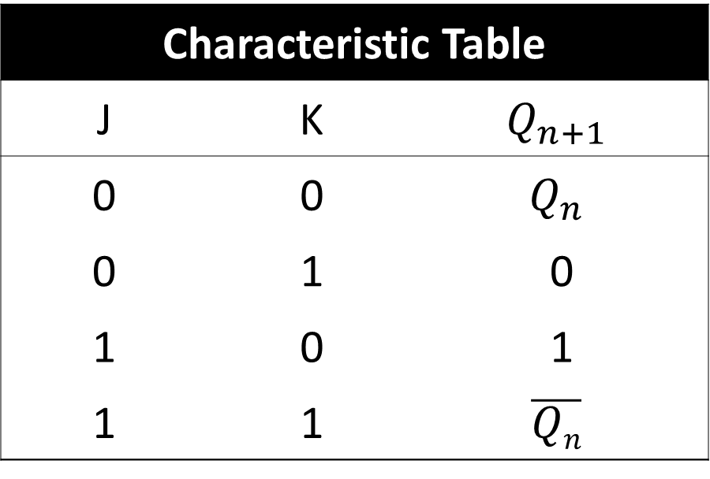
J-K Flip Flop（J-K触发器）
All possible input values valid
Same as S-R Flip Flop for inputs other than J=1 and K=1
If J=1 and K=1 then the output is reverse of current state
Characteristic Table
J | K | $$Q_{n+1}$$
0 | 0 | $$Q_{n}$$
0 | 1 | 0
1 | 0 | 1
1 | 1 | $$\overline{Qn}$$
JK触发器是基于cloked S-R latch进行改进的：
JK触发器通过增加两个与门，直接把「S=R=1」的无效状态变成了状态翻转功能，完全消除了约束条件。
可以把它理解为一个「带锁的开关盒」：平时时钟没到的时候，不管J、K怎么调，盒子里的内容（Q的输出）都不会变；只有时钟这把「钥匙」到来时，才会根据提前设置的J、K值，决定盒子里放0、放1、保持原样，还是把内容反过来

Slide 33
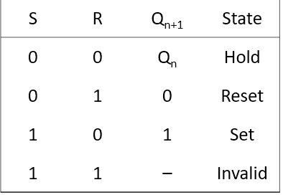
S-R Latch 、Clocked S-R Latch、D Flip Flop(DFF)、J-K Flip Flop对比
 | 电路图 | 特点 | 缺点
S-R Latch S-R锁存器 |  |  | 抗干扰能力差（毛刺输入也反应） 存在禁止态（S=1 R=1） 状态变化是随机的，发生在S/R跳变的任意时刻
Clocked S-R Latch 时控S-R锁存器 |  | 加入时钟同步控制 状态变化发生在Clk来临 电平触发（level-triggered） | 抗干扰能力比S-R Latch好，但CLK有效窗口内的毛刺、干扰还是会直接传到输出 存在禁止态（S=1 R=1）
D Flip Flop(DFF) D触发器 |  | 加入时钟同步控制 消灭了禁止态 时钟边缘触发(edgetriggered),抗干扰能力强
J-K Flip Flop J-K触发器 |  | 加入时钟同步控制 将禁止态变成了状态翻转 时钟边缘触发(edgetriggered),

Slide 34
DFF（D Flip Flop）
Data Flip Flop (aka latch)
The most elementary sequential gate: Outputs the input in the previous time-step
in
DFF
out
out(t) = in(t – 1)
最基本的顺序门：输出前一时间步的输入
time:
1
2
3
4
5
6
7
8
examples
of arbitrary inputs
in:
1
0
out:
1
0

Slide 35
DFF （D Flip Flop）
Data Flip Flop (aka latch)
The most elementary sequential gate: Outputs the input in the previous time-step
in
DFF
out
out(t) = in(t – 1)
time:
1
2
3
4
5
6
7
8
examples
of arbitrary inputs
in:
1
0
out:
1
0

Slide 36
DFF （D Flip Flop）
Data Flip Flop (aka latch)
The most elementary sequential gate: Outputs the input in the previous time-step
in
DFF
out
out(t) = in(t – 1)
time:
1
2
3
4
5
6
7
8
examples
of arbitrary inputs
in:
1
0
out:
1
0

Slide 37
DFF （D Flip Flop）
Data Flip Flop (aka latch)
The most elementary sequential gate: Outputs the input in the previous time-step
in
DFF
out
out(t) = in(t – 1)
time:
1
2
3
4
5
6
7
8
examples
of arbitrary inputs
in:
1
0
out:
1
0

Slide 38
DFF （D Flip Flop）
Data Flip Flop (aka latch)
The most elementary sequential gate: Outputs the input in the previous time-step
in
DFF
out
out(t) = in(t – 1)
time:
1
2
3
4
5
6
7
8
examples
of arbitrary inputs
in:
1
0
out:
1
0

Slide 39
DFF （D Flip Flop）
Data Flip Flop (aka latch)
The most elementary sequential gate: Outputs the input in the previous time-step
in
DFF
out
out(t) = in(t – 1)
time:
1
2
3
4
5
6
7
8
examples
of arbitrary inputs
in:
1
0
out:
1
0

Slide 40
DFF （D Flip Flop）
Data Flip Flop (aka latch)
The most elementary sequential gate: Outputs the input in the previous time-step
in
DFF
out
out(t) = in(t – 1)
time:
1
2
3
4
5
6
7
8
examples
of arbitrary inputs
in:
1
0
out:
1
0

Slide 41
DFF （D Flip Flop）
Data Flip Flop (aka latch)
The most elementary sequential gate: Outputs the input in the previous time-step
in
DFF
out
out(t) = in(t – 1)
time:
1
2
3
4
5
6
7
8
examples
of arbitrary inputs
in:
1
0
out:
1
0

Slide 42
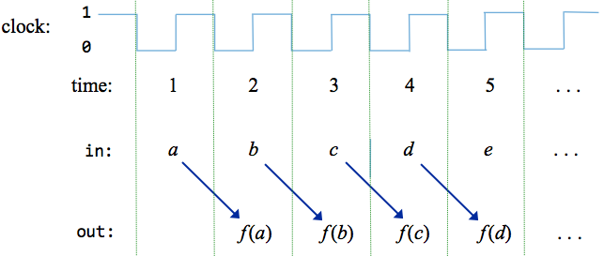
Combinational logic / Sequential logic
Combinational logic:
The output depends
on the current inputs
The clock is used to stabilize outputs
时钟用于稳定输出，避免毛刺
组合电路在同一个时钟周期内产生输出
Sequential logic:
The output depends on:
Previous inputs
Current inputs (optionally)
This behavior can be used to build chips designed to maintain state: Registers.
f(b,c)
时序电路在下一个时钟周期内产生输出
因为要保存上一个时钟周期的状态
f(a,b)
f(c,d)
f(d,e)

Slide 43
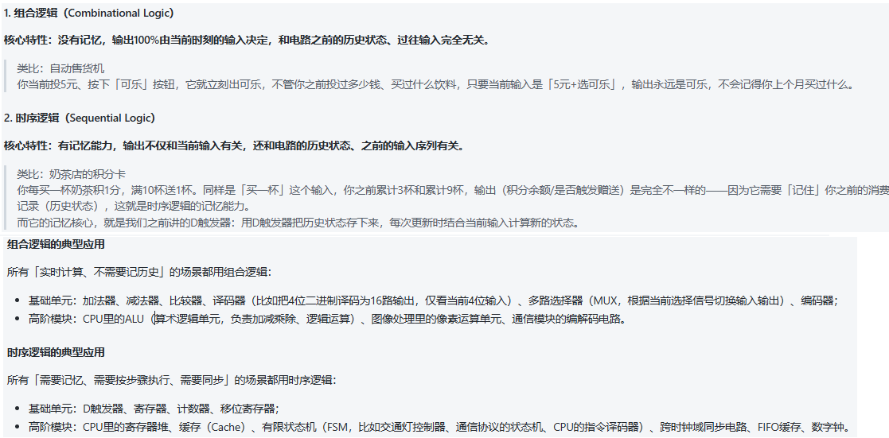
Combinational logic / Sequential logic

Slide 44
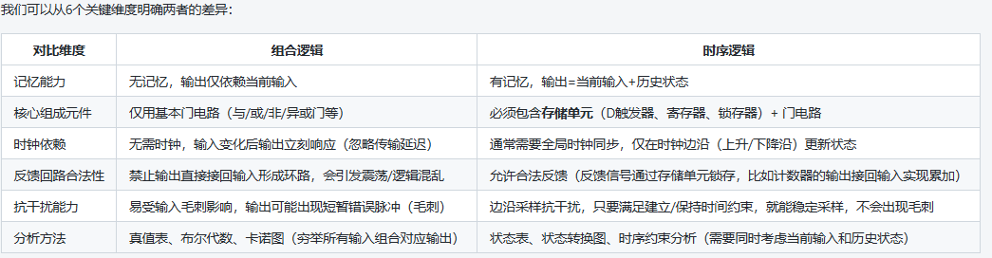
Combinational logic / Sequential logic

Slide 45
From DFF to a 1-bit register
Data Flip Flop (aka latch)
The most elementary sequential gate: Outputs the input in the previous time-step
in
DFF
out
out(t) = in(t – 1)
time:
1
2
3
4
5
6
7
8
examples
of arbitrary inputs
in:
1
0
out:
1
0
How can we “load” and then “maintain” a value (0 or 1) over time,
without having to feed the value in every cycle?
我们如何随着时间的推移“加载”并“保持”一个值（0或1），而不必在每个周期中都输入该值？

Slide 46
DFF implementation
除其他事项外，DFF门逻辑实现还需要将Nand门与反馈回路连接起来
最终的实现是优雅的，但不可能在提供的硬件模拟器上实现
硬件模拟器不允许组合芯片（如Nand）的循环
因此，我们将使用内置的DFF实现：
Part of a possible DFF implementation
/** Data Flip-flop: out(t) = in(t-1)
* where t is the current time unit. */
CHIP DFF {
IN in;
OUT out;
BUILTIN DFF;
CLOCKED in;
}

Slide 47
From DFF to a 1-bit register
in
DFF
out
out(t) = in(t – 1)
We have to realize a “loading” behavior and a ”storing” behavior,
and be able to select between these two states
How can we “load” and then “maintain” a value (0 or 1) over time,
without having to feed the value in every cycle?

Slide 48
From DFF to a 1-bit register
load
1-bit Register
Stores one bit over time
if load(t – 1) then
out(t ) = in(t – 1)
else
out(t) = out(t – 1)
in
DFF
out
软件的分支逻辑用硬件来实现就是Mux，sel放条件，T放b口, F放a口
We have to realize a “loading” behavior and a ”storing” behavior,
and be able to select between these two states
Behavior
if load == 1 the register’s value becomes in
else the register maintains its current value

Slide 49
1-Bit Register
1-Bit register CHIP的外部芯片视图
1-Bit register CHIP的内部芯片视图
load
a口的input连接的是out，所以不必暴露出来
in
Bit
out
if load(t – 1) then out(t ) = in(t – 1)
else out(t) = out(t – 1)
Usage:
To read:
probe out(检测out）
(out always emits（发射） the register’s state)
如果要读1-Bit register的value，直接检测Bit的out引脚即可
To write:
set in = v
set load = 1
Result: The register’s state becomes v;
From the next time-step onward, out will emit v
如果要向1-Bit register写入value(0/1)，需将load=1，in=v，
这样下个时钟周期Bit就会把v记录下来： out(t ) = in(t – 1)

Slide 50
1-Bit Register
load
in
Bit
out
if load(t – 1) then out(t ) = in(t – 1)
else out(t) = out(t – 1)
time:
1
2
3
4
5
6
7
8
1
load:
0
1
in:
0
1
out:
0

Slide 51
1-Bit Register
load
in
Bit
out
if load(t – 1) then out(t ) = in(t – 1)
else out(t) = out(t – 1)
注意：虽然当前时间周期load=1，但是时序电路是在下个周期处理上个周期的值的
time:
1
2
3
4
5
6
7
8
1
load:
examples
of arbitrary input values
0
1
in:
0
1
out:
0

Slide 52
1-Bit Register
load
in
Bit
out
if load(t – 1) then out(t ) = in(t – 1)
else out(t) = out(t – 1)
time:
1
2
3
4
5
6
7
8
1
load(t-1)
load:
examples
of arbitrary input values
0
in(t-1)
1
in:
0
1
out:
0
t = 2, load(t-1) = 1，in(t-1) = 1 ： out(t) = in(t – 1) = 1

Slide 53
1-Bit Register
load
in
Bit
out
if load(t – 1) then out(t ) = in(t – 1)
else out(t) = out(t – 1)
time:
1
2
3
4
5
6
7
8
1
load(t-1)
load:
examples
of arbitrary input values
0
1
in:
0
1
out:
0
out(t-1)
t = 3, load(t-1) = 0, out(t-1) = 1： out(t) = out(t – 1) = 1

Slide 54
1-Bit Register
load
in
Bit
out
if load(t – 1) then out(t ) = in(t – 1)
else out(t) = out(t – 1)
time:
1
2
3
4
5
6
7
8
1
load(t-1)
load:
examples
of arbitrary input values
0
1
in:
0
1
out(t-1)
out:
0
t = 4, load(t-1) = 0, out(t-1) = 1 ： out(t) = out(t – 1) = 1

Slide 55
1-Bit Register
load
in
Bit
out
if load(t – 1) then out(t ) = in(t – 1)
else out(t) = out(t – 1)
注意：虽然当前时间周期load=1，但是时序电路是在下个周期处理上个周期的值的
time:
1
2
3
4
5
6
7
8
1
load(t-1)
load:
examples
of arbitrary input values
0
1
in:
0
1
out(t-1)
out:
0
t = 5, load(t-1) = 0, out(t-1) = 1 ： out(t) = out(t – 1) = 1

Slide 56
1-Bit Register
load
in
Bit
out
if load(t – 1) then out(t ) = in(t – 1)
else out(t) = out(t – 1)
time:
1
2
3
4
5
6
7
8
load(t-1)
1
load:
examples
of arbitrary input values
0
1
in:
load(t-1)
0
1
out:
0
t = 6, load(t-1) = 1, in(t-1) = 0 ： out(t) = in(t – 1) = 0

Slide 57
1-Bit Register
load
in
Bit
out
if load(t – 1) then out(t ) = in(t – 1)
else out(t) = out(t – 1)
time:
1
2
3
4
5
6
7
8
1
load(t-1)
load:
examples
of arbitrary input values
0
1
in:
0
1
out(t-1)
out:
0
t = 7, load(t-1) = 0, out(t-1) = 0 ： out(t) = out(t – 1) = 0

Slide 58
1-Bit Register
load
in
Bit
out
if load(t – 1) then out(t ) = in(t – 1)
else out(t) = out(t – 1)
time:
1
2
3
4
5
6
7
8
1
load(t-1)
load:
examples
of arbitrary input values
0
1
in:
0
1
out(t-1)
out:
0
t = 8, load(t-1) = 0, out(t-1) = 0 ： out(t) = out(t – 1) = 0

Slide 59
1-Bit Register
load
in
Bit
out
if load(t – 1) then out(t ) = in(t – 1)
else out(t) = out(t – 1)
time:
1
2
3
4
5
6
7
8
1
load:
examples
of arbitrary input values
0
1
in:
0
1
out:
0
“storing”
“loading”
“storing”
Resulting behavior:
“loading”

Slide 60
1-bit Register
Bit.hdl
/** 1-bit register:
if load(t – 1) then out(t) = in(t – 1)
else out(t) = out(t – 1)) */
CHIP Bit {
IN in, load;
OUT out;
PARTS:
Mux(a=dffout, b=in, sel=load, out=muxout);
DFF(in=muxout, out=dffout,out = out);
}
load
in
Bit
out
load
Implementation tip:
Follow the chip diagram
in
out

Slide 61
Multi-bit Registers
Memory
(many registers)
CPU
Input
ALU
Output
Registers
Computer Architecture

Slide 62
Multi- bit Registers
A register is a collection of bits
The width of a register is dependent on the architecture
  Our architecture is 16-bit
Share a common load control bit

Slide 63
16-bit Register
Register.hdl
/** 1-bit register:
if load(t – 1) then out(t) = in(t – 1)
else out(t) = out(t – 1)) */
CHIP Bit {
IN in[16], load;
OUT out[16];
PARTS:
Bit(in=in[0] , load= load, out=out[0] );
Bit(in=in[1] , load= load, out=out[1] );
Bit(in=in[2] , load= load, out=out[2] );
Bit(in=in[3] , load= load, out=out[3] );
Bit(in=in[4] , load= load, out=out[4] );
Bit(in=in[5] , load= load, out=out[5] );
Bit(in=in[6] , load= load, out=out[6] );
Bit(in=in[7] , load= load, out=out[7] );
Bit(in=in[8] , load= load, out=out[8] );
Bit(in=in[9] , load= load, out=out[9] );
Bit(in=in[10], load= load, out=out[10] );
Bit(in=in[11], load= load, out=out[11] );
Bit(in=in[12], load= load, out=out[12] );
Bit(in=in[13], load= load, out=out[13] );
Bit(in=in[14], load= load, out=out[14] );
Bit(in=in[15], load= load, out=out[15] );
}
load
in
out
Register
16
16
Register.tst
set in -321,
set load 1,
tick, // tick是低电平，Register不做处理
output; // output表格中，Register值不变
// tock是高电平，执行tock的瞬间就是时钟上升沿，会触发所有时序器件（DFF、Bit、寄存器等）采样输入、更新输出
tock,
output; // output表格中，Register值变成-321

Slide 64
Counters
We have discussed that the computer must keep track of which instruction should be fetched and executed next
This task is regulated by a register typically called Program Counter
We’ll use the PC to store the address of the instruction that should be fetched and executed next
The PC should support three abstractions:
  Reset: fetch the first instruction
  Next: fetch the next instruction
  Goto: fetch instruction n
PC = 0
PC++
PC = n

Slide 65
Counters
Counters are a combination of combinatorial and sequential logic
Counters implement
  Reset
  Increment by 1
  Set to some specified value
PC = 0
PC++
PC = n

Slide 66
16-bit Counter(太复杂，不做要求)
/**
A 16-bit counter with control bits.
if reset(t – 1) out(t) = 0 // resetting
else if load(t – 1) out(t) = in(t – 1) // setting
else if inc(t – 1) out(t) = out(t – 1) + 1 // incrementing
else out(t) = out(t – 1) // maintaining
*/
CHIP PC {
IN in[16], load, inc, reset;
OUT out[16];
PARTS:
// Put your code here:
}
load
inc
reset
in
out
16
PC (counter)
16
Implementation tip: Can be built from a Register, an Incrementer, and Mux’s

Slide 67
Counter
load
inc
reset
if reset(t) out(t + 1) = 0
else if load(t) out(t + 1) = in(t)
else if inc(t) out(t + 1) = out(t) + 1
else out(t + 1) = out(t)
in
out
16
PC (counter)
16
Usage:
To read:
probe out
To set:
set in to v,
assert load,
set the other control bits to 0
To reset:
assert reset,
set the other control bits to 0
To count:
assert inc,
set the other control bits to 0

Slide 68
Summary
Introduced the concept of clocks & understand their use in computer systems
Discussed the difference between Sequential & Combinational logic
Looked at how Registers work and how they can be used to build memory and counters
Implement the circuits required to implement registers and Program Counter..

